Slide 1
22CSC51 - AGILE METHODOLOGIES
Prepared By,
Ms.A.KIRUTHIKA,
Assistant Professor
Department of CSE
Kongu Engineering College

Slide 2
Unit - III
XP and Incremental Design, Lean, and Kanban

Slide 3
XP Extreme Programming
XP is a lightweight, efficient, low-risk, flexible, predictable, scientific, and fun way to develop software.
Suitable for small to medium sized projects that works under vague and rapidly changing environment, usually ranged from 6 to 15 months.
XP was used by small teams ranging from two to twelve members.
Kent Beck in 1999 invented XP to meet the changing requirements needed in the market place.
Goals:
  Minimize unnecessary work
  Maximize communication and feedback
  Make sure that developers do most important work
  Make system flexible, ready to meet any change in requirements

Slide 5
XP Variables
XP regards a software development project as a system of four control “variables”:
1. Cost 3. Quality
2. Scope 4. Time
Cost
The amount of money to be spent. The resources (how many developers, equipment etc.) available for the project are directly related to this variable.
Time
Determines when the system (release) should be done.
Quality
The correctness of the system (as defined by the customer) and how well tested it will be.
Scope
Describes what and how much will be done (functionality).

Slide 6
Relationship between Variables
Time is the central variable in XP.
Increasing quality can increase the time
Increasing scope means more time is needed
Increasing cost (hiring more developers or providing better equipment) can mean less time

Slide 7
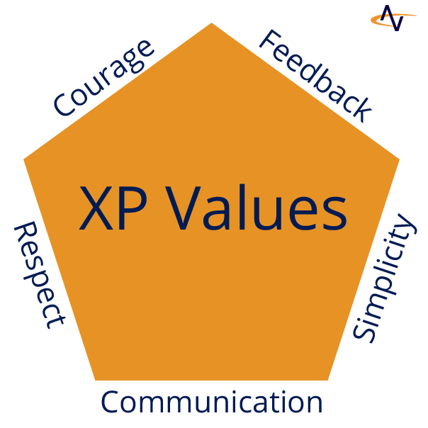
XP Values
XP defines four “values” which are used as guidelines throughout development.
Communication
Simplicity
Feedback
Courage
Respect

Slide 8
XP Values
Communication
Good communication is one of the key factors necessary for the success of software projects.
Customers need to communicate the requirements to the developers. Developers communicate ideas and design to each other and so on.
A lot of problems can be traced to a breakdown in communication.
XP tries to keep communication flowing in a variety of ways.

Slide 9
XP Values
Simplicity
XP strives for simple systems. This means, they should be as simple as possible but they must work.
XP also strives for simplicity in the methodology.
It reduces the amount of artifacts to an absolute minimum
– the requirements (User Stories), plans (Planning Game) and the product (code).
The practices and techniques can be learned in a matter of hours
The main reason for the desire for simplicity is that XP tries to cope with changes and other risks.
Simplicity means that you always strive to “Do The Simplest Thing That Could Possibly Work”

Slide 10
XP Values
Feedback
XP is a feedback-driven process. You need feedback at all scales, whether you are a customer, manager or developer.
  In XP feedback is especially relevant to business because it is the base for influencing the process.
Feedback has two important characteristics.
  The first is quality.
  The second is time.

Slide 11
XP Values
Courage
This is a somewhat vague value.
It includes courage as well as a certain amount of aggressiveness.
Courage is needed because a lot of the rules and practices are “extreme” in the way that they go against “tradition” or “wisdom” of software engineering.
Aggressiveness is the attitude towards the implementation of the system.

Slide 12
XP Values
Respect
Team members respect each other
When team members have mutual respect, they’re able to trust each other to do a good job with the work they’ve taken on.
But that respect doesn’t always come easily to programmers and other technical people.
A good XP finds ways to increase the team members’ mutual respect for each other.

Slide 13
XP Principles
Humanity
Economics
Mutual benefit
Self similarity
Improvement
Diversity
Reflection
Flow
Opportunity
Redundancy
Failure
Quality
Accepted responsibility
Baby steps

Slide 14
XP Principles
Humanity
Remember that software is built by people, and there’s a balance between the needs of each team member and the project’s needs.
Economics
Somebody is always paying for software project and everybody has to keep the budget in mind.
Mutual benefit
Search for practices that benefit the individual, the team, and the customer together.
Self Similarity
The pattern of a monthly cycle is the same as a weekly cycle and the same as a daily cycle.

Slide 15
XP Principles
Improvement
Do your best today, and stay aware of what you need to do to get better tomorrow.
Diversity
Lots of different opinions and perspectives work together to come up with better solutions.
Reflection
Good teams stay aware of what’s working and what isn’t in their software process.
Flow
Constant delivery means a continuous flow of development work, not distinct phases.
Opportunity
Each problem the team encounters is a chance to learn something new about software development.

Slide 16
XP Principles
Redundancy
Even though it can seem wasteful at first blush, redundancy avoids big quality problems.
Failure
You can learn a lot from failing. It’s OK to try things that don’t work.
Quality
You can’t deliver faster by accepting a lower quality product.
Accepted responsibility
If someone is responsible for something, they need to have the authority to get it done.
Baby steps
Take small steps in the right direction rather than making wholesale changes when adopting new practices.

Slide 17
XP Practices
There are 13 Primary Practices . These are grouped into the following 4 Categories
Programming Practices
Integration Practices
Planning Practices
Team Practices

Slide 18
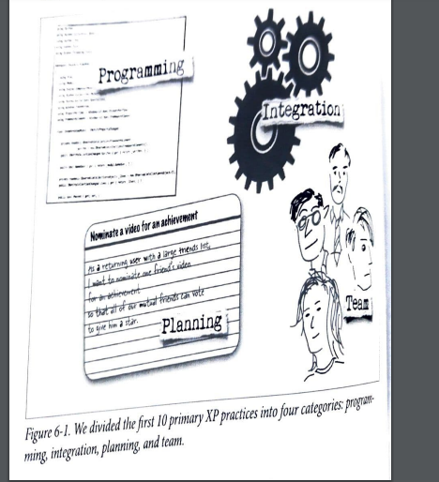
XP Practices

Slide 19
XP Practices
Business or Planning Practices
1. The Planning Game
2. Small Release
3.Metaphor
4.On Site Customer
Team Work Practices
1. Collective Ownership
2. Coding Standard
3. Refactoring
4. 40 Hours a week
Programming Practices
1. Simple Design
2. Test Driven Development
3. Pair Programming
Integration Practices
1. Continuous Integration
2. 10 Minute Build

Slide 20
XP Practices
The Planning Game—Quickly determine the scope of the next release by combining business priorities and technical estimates. As reality overtakes the plan, update the plan.
Small releases—Put a simple system into production quickly, then release new versions on a very short cycle.
Metaphor—Guide all development with a simple shared story of how the whole system works.
Simple design—The system should be designed as simply as possible at any given moment.
Extra complexity is removed as soon as it is discovered.

Slide 21
XP Practices
Testing—Programmers continually write unit tests, which must run flawlessly for development to continue.
Customers write tests demonstrating that features are finished.
Refactoring—Programmers restructure the system without changing its behavior to remove duplication, improve communication, simplify, or add flexibility.
Pair programming—All production code is written with two programmers at one machine.
Collective ownership—Anyone can change any code anywhere in the system at any time.

Slide 22
XP Practices
Continuous integration—Integrate and build the system many times a day, every time a task is completed.
40 hour week—Work no more than 40 hours a week as a rule.
Never work overtime a second week in a row.
On-site customer—Include a real, live user on the team, available full-time to answer questions.
Coding standards—Programmers write all code in accordance with rules emphasizing communication through the code.

Slide 23
The Planning Game
Neither business considerations nor technical considerations should be paramount.
Software development is always an evolving dialog between the possible and the desirable.
The nature of the dialog is that it changes both what is seen to be possible and what is seen to be desirable.
Business people need to decide about
Scope—How much of a problem must be solved for the system to be valuable in production?
Priority—If you could only have A or B at first, which one do you want? The business person is in a position to determine this, much more so than a programmer.

Slide 24
The Planning Game
Composition of releases—How much or how little needs to be done before the business is better off with the software than without it?
Dates of releases—What are important dates at which the presence of the software (or some of the software) would make a big difference?
Technical people decide about
Estimates—How long will a feature take to implement?

Slide 25
The Planning Game
Consequences—There are strategic business decisions that should be made only when informed about the technical consequences.
Process—How will the work and the team be organized? The team needs to fit the culture in which it will operate.
Detailed scheduling—Within a release, which stories will be done first? The programmers need the freedom to schedule the riskiest segments of development first, to reduce the overall risk of the project.

Slide 26
Small Releases
Every release should be as small as possible, containing the most valuable business requirements.
The release has to make sense as a whole—that is, you can't implement half a feature and ship it, just to make the release cycle shorter.
It is far better to plan a month or two at a time than six months or a year at a time.
A company shipping bulky software to customers might not be able to release this often.
They should still reduce their cycle as much as possible.

Slide 27
Metaphor
Extreme Programming teams develop a common visionof how the program works, which we call the "metaphor".
At its best, the metaphor is a simple evocative description of how the program works.
Each XP software project is guided by a single overarching metaphor.
The metaphor just helps everyone on the project understand the basic elements and their relationships.
Metaphor is something you start using when your mother asks what you are working on and you try to explain her the details.
How you find it is very project-specific. Use your common sense or find the guy on your team who is good at explaining technical things to customers in a way that is easy to understand.

Slide 28
Simple Design
Always use the simplest possible design that gets the job done.
The requirements will change tomorrow, so only do what’s needed to meet today’s requirements.
The system should be designed as simply as possible at any given moment.
Extra complexity is removed as soon as it is discovered.

Slide 29
Test-Driven Development (TDD)
In XP Developers write the unit test cases before starting the coding.
The team automates the unit tests and it helps during the build and integration stage.
The main benefit of TDD is that programmers have to only write the code that passes the tests.
Basics steps of TDD,
Write the unit test case first
Write a minimal amount of code to pass the test.
Refactor it by adding the needed feature and functionality, While continuously making sure the tests pass.

Slide 30
Refactoring
XP uses Refactoring to enhance the design of a system such that it is easier to understand and modify without affecting the behavior.
If a Refactoring would not enhance the system, then it is not applied.
Furthermore, Refactoring is only done as part of the development cycle: before and after the implementation of a task (before implementation to ease the integration of the new code).
Refactoring do not affect the behavior.
Refactoring can have a slightly negative effect on performance, but the code tends to be better suited to optimization later on.

Slide 31
Pair Programming
In a team that does pair programming, two developers sit together at a single workstation when writing code.
In most cases, one programmer types, while the other watches—
  Is the overall system going to work
  Are there better ways of doing this
  What test cases still don’t work
and they constantly discuss what’s going on.
Teams working in pairs inject far fewer bugs, because there are two sets of eyes looking to catch the bugs all the time.
Pairs switch roles frequently (every two hours)

Slide 32
Collective Ownership
The code (classes etc.) created in an XP project is owned by the complete team, not by the individual developers.
This is important because anyone has to be able to modify anything if necessary.
Any developer is expected to be able to work on any part of the codebase at any time.
However problems with Collective Code Ownership arise when
a strong ownership mentality exists
non-project components are (re)used
expert knowledge is needed

Slide 33
Continuous Integration
All changes are integrated into the codebase at least daily.
Unit tests have to run 100% both before and after integration.
The whole system is built and tested several times a day
The benefits of frequent integration are :
Integration is easier because the changes are small.
The unit test suite ran fine before integration.
If problems are discovered by the suite they probably are located in the changes.
The codebase represents the current state of the system. If a snapshot is needed it can be created anytime from the codebase stored in the integration computer.

Slide 34
10 – Minute Build
The team creates an automated build for the entire code base that runs in under 10 mins
This build includes automatically running all of the unit tests and generating a report of which test passed and which failed
If a build takes more than 10 minutes to run, team members are much less likely to run it often.

Slide 35
40 Hours a week
XP projects emphasize the forty hour week. This means that the team should avoid to work overtime.
Two reasons are given for this rule :
“Projects that need working overtime will be too late anyway.”
Usually either the schedule is too tight (business controls both time and scope) or the team couldn’t cope in time with unexpected risks. The only way to deal with the latter is to re-negotiate the schedule, otherwise the quality will be decreased.
· The motivation will be affected. For most of XP’s rules and practices it is necessary that the team members are rested and motivated.
In practice, XP projects rarely require working overtime, and if so, at most one or two times during the whole project.

Slide 36
On-Site Customer
In almost all phases of XP communication with the customer is necessary.
Therefore, a real customer who is familiar with the problem domain (if possible an expert) and who is a potential user of the system is part of the development team.
He or she will sit with the team and be available to provide additional information necessary to implement a user story (story refinement) answer questions and resolve disputes about the meaning of domain aspects set priorities at a small scale (the choice of stories for an iteration) write functional tests and run them at the end of the iteration (with help from the Tester)

Slide 37
Coding Standards
XP projects use rules and guidelines for naming and formatting code units. This means, every developer chooses the names of classes, methods, variables etc. after these rules. The Coding Standards can come from the outside or are defined by the development team.
The standards make the system more consistent so that it is easier to read, understand, and work with (extend, refactor).
It is also a great help when somebody (perhaps a new team member) needs to learn the system.
Therefore it is important that every team member follows the rules. If an XP developer finds some part of the system that doesn’t follow the standards, he or she changes it accordingly (this, of course, needs Collective Code Ownership).
Note that Coding Standards relate to the System Metaphor.

Slide 38
The Practices support each other

Slide 39
XP Roles
eXtreme Programming defines the following roles
· Customer
· Programmer
· Coach
· Tracker
· Tester

Slide 40
XP Roles
Customer
The customer defines what to do (User Stories) and in what order (Planning Games).
XP has a special rule called On-Site Customer.
Programmer
XP is a programmer-centric methodology.
It does not make use of specialists like analysts, software architects or software designers.
Instead this work is performed by the programmers.
There are several skills that the programmer must have
  Communication
  Coding
  Ability to work in team

Slide 41
XP Roles
Coach
The coach is responsible for the technical execution (and evolution) of the project.
· Tracker
The tracker will ask each developer every two or three days how much time they have spent on each of their
tasks and how much time is left.
· Tester
The tester helps the customer to choose and write the functional tests and run them (especially the tests that cannot be automated).

Slide 42
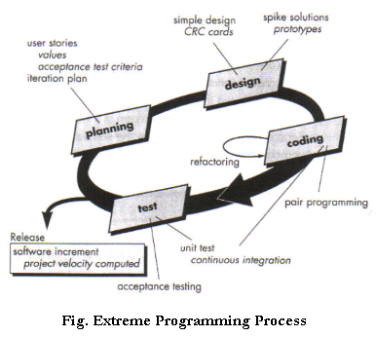
XP Process

Slide 43
Planning
The first phase of Extreme Programming life cycle is planning, where customers or users meet with the development team to create ‘user stories’ or requirements.
The development team converts user stories into iterations that cover a small part of the functionality or features required.
A combination of iterations provides the customer with the final fully functional product.
It includes
Exploration,
Planning, and
Steering
In the exploration phase the customer defines what he/she wants the system to do and the developers estimate how long it will take to implement the desired behavior.

Slide 44
Planning
In the planning phase both parties negotiate which of the desired features can be done within the given bounds (time, resources).
Steering means influencing the process by little moves.
It consists of four possible “moves” :
· Iteration
· Recovery
· New story
· Re-estimation

Slide 45
A User Story card from the C3 project

Slide 46
Designing
An iteration of XP programming starts with designing.
Using Software Class Responsibilities and Collaboration (CRC) Cards that allow for a departure from the traditional procedural mindset and make possible object oriented technology.
Such cards allow all members of the project team to contribute ideas, and collate the best ideas into the design
Creating spike solutions or simple programs that explore potential solutions for a specific problem, ignoring all other concerns, to mitigate risk

Slide 47
Coding
Coding constitutes the most important phase in the Extreme Programming life cycle.
XP programming gives priority to the actual coding over all other tasks such as documentation to ensure that the customer receives something substantial in value at the end of the day.
Standards related to coding include:
Developing the code based on the agreed metaphors and standards, and adopting a policy of collective code ownership.
Pair programming or developing code by two programmers working together on a single machine, aimed at producing higher quality code at the same or less cost.
Strict adherence to 40-hour workweeks with no overtime.

Slide 48
Testing
Extreme program integrates testing with the development phase rather than at the end of the development phase.
All codes have unit tests to eliminate bugs, and the code passes all such unit tests before release.
Another key test is customer acceptance tests, based on the customer specifications.
Acceptance test run at the completion of the coding, and the developers provide the customer with the results of the acceptance tests along with demonstrations.

Slide 49
Feedback Loops
XP teams aim for a very short iteration—the weekly cycle—to increase feedback and shorten the feedback loop.
To keep feedback loops short, they continuously reflect on how the project is going.
If there’s a problem then the team will talk about it. Osmotic communication from sitting together helps spread that feedback around the team.
As they communicate more and get more continuous feedback, they start seeing bottlenecks in the way they’re building software, and they learn to work around obstacles together as a team.

Slide 50
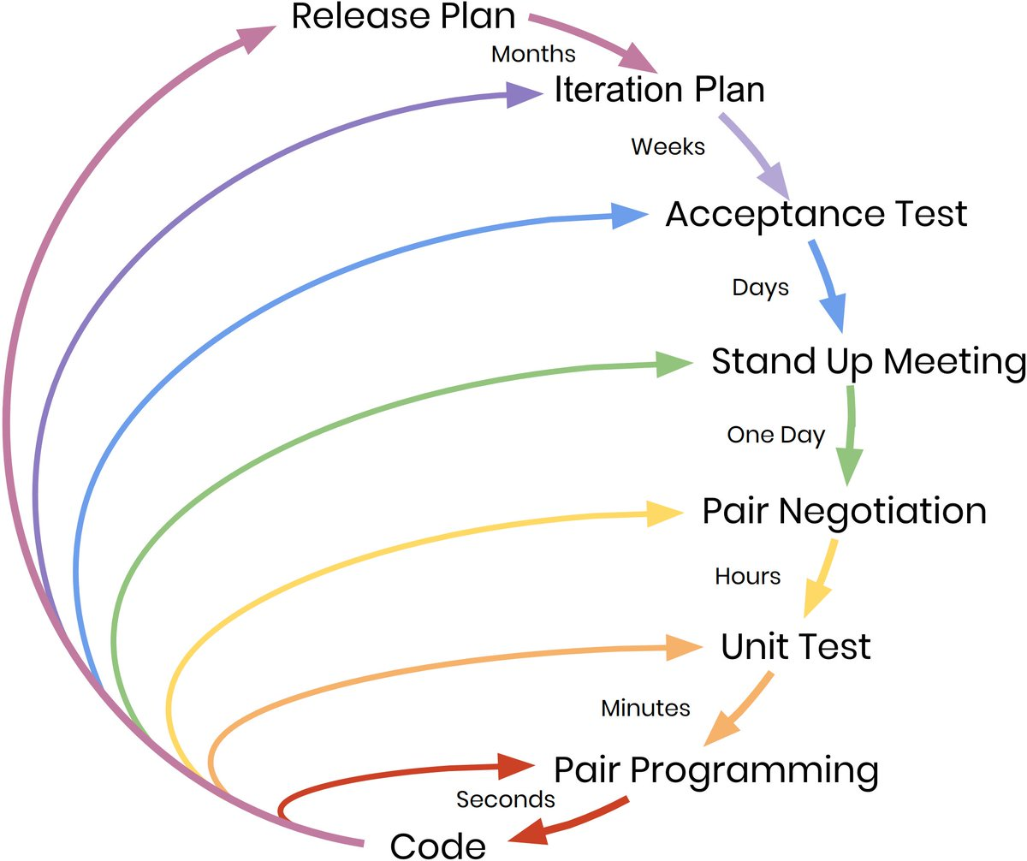
Feedback Loops

Slide 51
Feedback loops

Slide 52
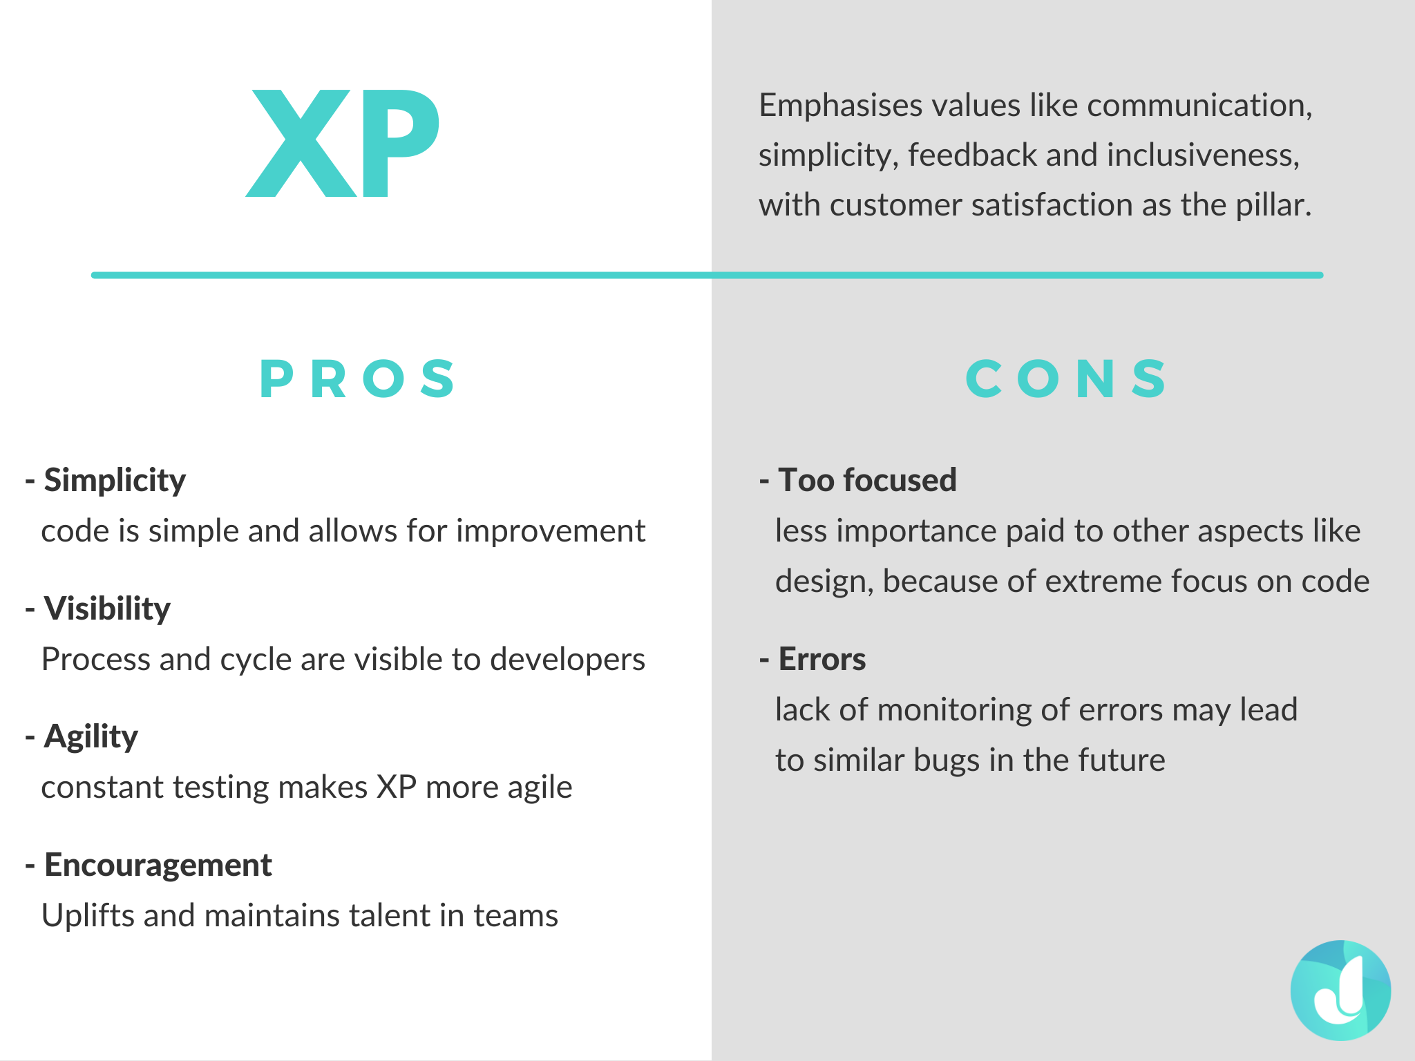

Slide 53
Lean
Origin:
Management philosophy developed from Toyota Production System (TPS)
The term “lean” has been applied to manufacturing for many decades; it was adapted for software development by Tom and Mary Poppendieck in the first decade of the twenty-first century.
Use capital-L term “Lean” to refer to this adaption of lean ideas to agile software development.
Lean is different. Unlike Scrum and XP, Lean doesn’t include a set of practices. Lean is a mindset.
The mindset of lean is sometimes called lean thinking.

Slide 54
Definition
A term Focused on improving process speed and quality through reduction of process wastes.
Lean thinking:
A business methodology which aims to provide a
new way to think about how to organize human activities to deliver more benefits to society and value to individuals while eliminating waste.
Simple Definition:
“Becoming ‘lean’ is a process of eliminating waste with the goal of creating value.”

Slide 55
Lean values
Eliminate waste
Amplify learning
Decide as late as possible
Deliver as fast as possible
Empower the team
Build integrity in
See the whole

Slide 56
Eliminate waste
Waste in lean is everything that does not contribute to the value for the customer, i.e. everything that does not help to fulfill the needs of the customer or does delight the customer.
Seven types of waste were identified in manufacturing and mapped to software development.
1.Partially done work 2. Extra processes
3. Extra features 4. Task switching
5. Waiting 6. Motion 7. Defects
The wastes slow down the development flow and thus should be removed to speed up value creation.

Slide 57
Amplify learning
Use feedback from your project to improve how you build software.
In every iteration, there can be a new practice or learning to be gained, since we don’t expect perfect work within the first delivery;
Software development is a knowledge-intensive process where learning happens during the whole development lifecycle and needs to be amplified.
Learning includes getting a better understanding of the customer needs, potential solutions for architecture, good testing strategies, and so forth

Slide 58
Decide as late as possible
Make every important decision for your project when you have the most information about it—at the last responsible moment.
Rather than making early decisions and prone to error, it’s better to decide late after getting enough information for practices that involve uncertainty;
A commitment should be delayed as far as possible for irreversible decisions.
For example, a tough architectural decision might require some experimentation and therefore should not be committed early.
Instead, the option for change should be open for as long as possible.

Slide 59
Deliver as fast as possible
Lean has a strong focus on short cycle times, i.e. to minimize the time from receiving a request for a feature to the delivery of the feature.
The reason for the strong focus on cycle time is that while a feature is under development it does not create value for the customer.
Understand the cost of delay, and minimize it using pull systems and queues.
Though speedy delivery customers can get “what they need now” rather than “what they needed yesterday” and moreover, it also helps to facilitate the learning process when deliver cycles are shorter;

Slide 60
Empower the team
Establish a focused and effective work environment, and build a whole team of energized people.
Involving workers in key decision making so that they know what need to be done by themselves and this is performed by using pull mechanism;
The three principles that were used in the context of the Toyota Product Development System fostering the respect for people:
Entrepreneurial leadership
Expert technical workforce
Responsibility-based planning and control

Slide 61
Build integrity in
Build software that intuitively makes sense to the users, and which forms a coherent whole.
Delivering a system that exactly matches and fulfills the user’s wishes and needs; “Software with integrity has a coherent architecture, scores high on usability and fitness for purpose, and is maintainable, adaptable, and extensible.”
Quality of the software product should be built in as early as possible, and not late in development by fixing the defects that testing discovered.
In result the integrity of the software in development should be high at any point in time during the development lifecycle.
For example, if a defect is discovered early in the development process the ongoing work must be stopped and the defect fixed.

Slide 62
See the whole
Implement deep expertise in every system area to enhance the overall system performance.
Understand the work that happens on your project—and take the right kind of measurements to make sure you’re actually seeing everything clearly, warts and all.
When improving the process of software development the whole value-stream needs to be considered end to end (E2E).
For example, there is no point in sub-optimizing the requirements process and by that increase the speed of the requirements flow into coding and testing if coding can only implement the requirements in a much slower pace.

Slide 63
Seven Wastes of Software Development
Partially done work
When you’re doing iteration, you only deliver work that’s “done done” because if it’s not 100% complete and working, then you haven’t delivered value to your users.
Any activity that doesn’t deliver value is waste.
Extra processes
Processing beyond the standard.
All that extra effort going through the process of tracking and reporting time doesn’t create any value.

Slide 64
Seven Wastes of Software Development
Extra features
Creating more information or tests than needed.
When the team builds a feature that nobody has asked for instead of one that the users actually need, that’s waste.
Sometimes this happens because someone on the team is very excited about a new technology, and wants an opportunity to learn it.
This might be valuable to the person who improved their skillset, and that might even be valuable in the future for the team.
But it doesn’t directly help build valuable software, so it’s all waste.

Slide 65
Seven Wastes of Software Development
Task switching
Unnecessary movements between processes.
Some teams are expected to multitask, and often this multitasking gets out of hand.
Team members feel like they already have a full-time job (like building software), plus many additional part-time tasks added on (like support, training, etc.)—and every bit of work is critical and top priority.
The Scrum value of Focus helped us see that switching between projects, or even between unrelated tasks on the same project, adds unexpected delays and effort, because context switching requires a lot of cognitive overhead. Now we have another word for this: waste.

Slide 66
Seven Wastes of Software Development
Waiting
People or items that wait for a work cycle to be completed
There are so many things that professional software developers have to sit around and wait for: someone needs to finish reviewing a specification, or approve access to some system that the project uses, or fix a computer problem, or obtain a software license... these are all waste.
Motion
Unnecessary movement with a process
When the team doesn’t sit together, people literally have to stand up and walk to their team members in order to have a discussion.
This extra motion can actually add days or even weeks to a project if you add up all of the time team members spend walking around.

Slide 67
Seven Wastes of Software Development
Defects
Test-driven development prevents a lot of defects.
Every developer who is “test infected” had that “a ha” moment where a unit test caught a bug that would have been very painful to fix later, and realized that it took a lot less time to write all of the tests than it would have to track down that one bug—especially if a user discovers the bug after the software is released.
On the other hand, when the team needs to stay late scrambling to fix bugs that could have been prevented, that’s waste.

Slide 69
Lean Thinking

Slide 70
Lean Tools
Just-in-time
Kaizen
Queuing Theory
Leadership
Cost of delay
Value stream mapping

Slide 71
Value Stream Map
In Lean Software Development, Mary and Tom Poppendieck recommend a simple pencil-and-paper exercise to help you find waste.
It’s called a value stream map, and you can build one for any process.
Like many techniques used in conjunction with Lean, it originated in manufacturing, but it makes sense for software teams as well.

Slide 72
Steps in Value Stream Map
Start with a small unit of value that the team has already built and delivered to the customers or users.
Try to find the smallest unit possible— this is an example of a minimal marketable feature (MMF), or the smallest “chunk” of the product that the customers are willing to prioritize.
Think back through all of the steps that the unit went through from inception to delivery.
Draw a box for every one of these steps, using arrows to connect the boxes.
Because you’re drawing the actual path that a real feature took through your project, this will be a straight line— there are no decision points or forks in the path, because it represents the actual history of a real feature.
An MMF often takes the form of a user story, requirement, or feature request.

Slide 73
Value Stream Map
The value stream map clearly shows how much wait time was involved during the process.
It took a total of 71 days from the time the team started work on it to the time that it was deployed.
Of those 71 days, 35.5 were spent waiting rather than working.

Slide 74
Find the Root Cause of Problems
Lean teams utilize a technique called Five Whys to figure out the root cause of a problem.
Why is the average lead time so long?
Because it’s taking over six months for most users’ feature requests to make it into the software.
Why is it taking over six months for users’ requests to make it into the software?
Because those feature requests are almost always pushed back to make room on the schedule for last-minute changes.
Why are there so many last-minute changes?
Because before the team can release software to the users, they need to do a review with senior managers, and those senior managers almost always ask for basic, foundational changes.

Slide 75
Find the Root Cause of Problems
Why do the senior managers almost always ask for basic, foundational changes?
Because they all have very specific opinions about how the software should look, how it needs to function, and sometimes even the technical tools that should be used to build it, but the team doesn’t hear those opinions until after they’ve built
all of the code and have demoed it to the senior managers.
• Why doesn’t the team hear those opinions until after they’ve built all of the code and given a demo?
Because the senior managers are too busy to talk to the team early in the project, so they’ll only attend the final demo—and send the team back to the drawing board after the software is finished.

Slide 76
Area Chart to Visualize Work in Progress
This is a simple diagram that shows how the minimal marketable features are flowing through your value stream.
If you’ve created a value stream map, then you can build a WIP area chart, which is an area chart that shows how features, products, or other measures of value flow through every part of the value stream.
This works best if you use MMFs, because they represent the minimally sized “chunk” of value that’s created.
The goal of the WIP area chart is to show a complete history of the work in progress —all of the valuable features that the team is currently working on.
The chart will show us how many MMFs were in progress on any date, and how those MMFs broke down across the various value stream stages.
The work in progress is a measurement of features

Slide 77
Area Chart
We’ll use this value stream map to build a work-in-progress (WIP) area chart.
To build the WIP area chart, start with an x-axis that shows the date, and a y-axis that shows the number of MMFs.
The chart has a line for each of the boxes in the value stream map.
The lines divide the chart into areas for boxes in the value stream map.

Slide 78
Area Chart
There are no MMFs in progress before the project starts, so there’s just a single dot at X=0 at the lefthand side of the diagram (day 0).
Let’s say that when the project starts, the team starts working with the users on nine user stories, and they’re using those user stories as MMFs for their project.
Then a few days later, they add three more stories.
You’ll draw a dot at 9 for the first day, then another at 9 + 3 = 12 when those new MMFs were added, and you’ll connect them.

Slide 79
Area Chart

Slide 80
Area Chart
A few days later, the programmers start working on creating the design wireframes for four of the stories, so those four stories have progressed to the next stage in the value stream.

Slide 81
Area Chart
It’s useful to remove the “done” tasks from the chart, and use different shades for each stripe to make it easy to figure out which columns they correspond to.
This is why most WIP area charts do not include completed tasks.

Slide 82
Pull Systems
A pull system is a way of running a project or a process that uses queues or buffers to eliminate constraints.
Pull systems are very useful for building software—maybe not surprisingly, for exactly the same reason that they’re useful in manufacturing.
Instead of having users, managers, or product owners push tasks, features, or requests down to a team, they’ll add those requests to a queue that the team pulls from.
When work backs up and causes unevenness partway through the project, they can create a buffer to help smooth it out.
The team may have several different queues and buffers throughout their project.
And as it turns out, this is a very effective way of reducing waiting time, cutting out waste, and helping users, managers, product owners, and software teams decide on what software is built.

Slide 83
3 wastes identified by Pull System

Slide 84
waste that happens when the team is waiting for a large specification to be created and approved.

Slide 85
Pull System
A pull system is a better way to remove this unevenness and prevent the overburdening.
The first step in creating a pull system is to break the work down into small, pullable chunks.
So instead of building a large spec, the team can break it into minimal marketable features—say, individual stories, and maybe a small amount of documentation to go with each story.
Those stories would then be approved individually.
Typically, when a spec review process is held up for a long time, it’s because people have problems with some of the features.

Slide 86
Pull System
Approving individual MMFs should allow at least a few features to get approved quickly.
As soon as the first MMF has been approved, the team can start working on it.
Now the team doesn’t have to guess. Instead, there’s a real discussion of the work that needs to be done.

Slide 87
Kanban
Kanban is a method for process improvement used by agile teams.
Teams that use Kanban start by understanding the way that they currently build software, and make improvements to it over time.
Like Scrum, Kanban requires a mindset.
Kanban is a manufacturing term, adapted for software development by David Anderson.

Slide 88
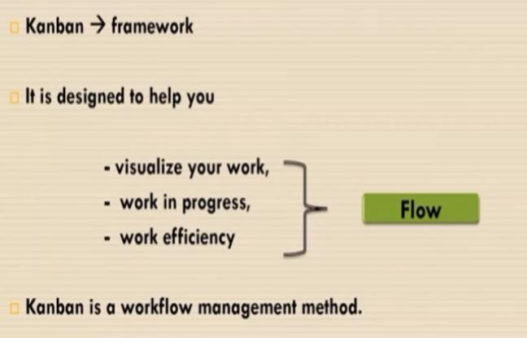
Kanban

Slide 89
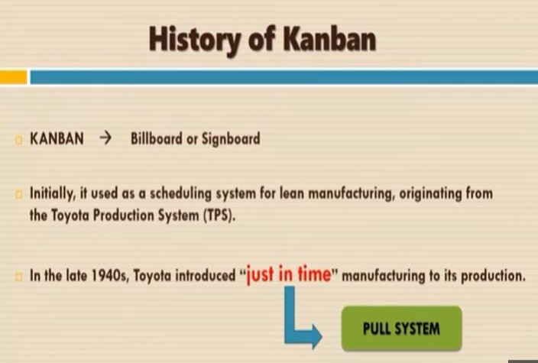

Slide 90
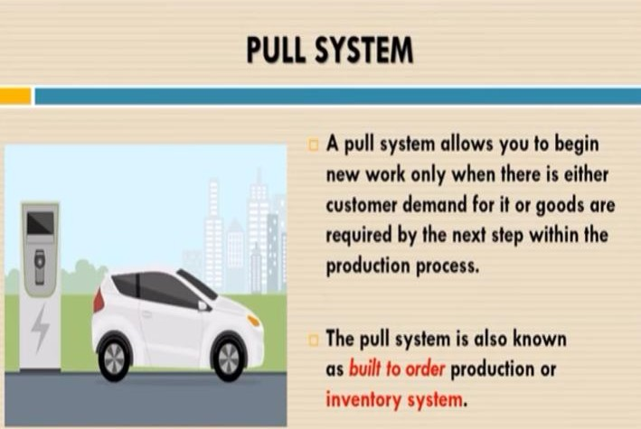

Slide 91
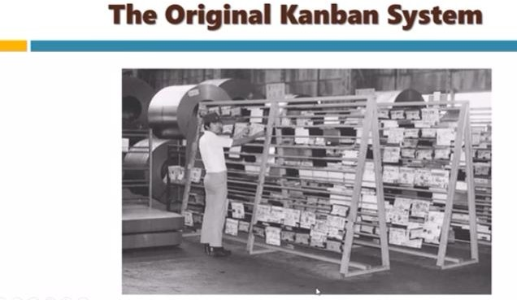

Slide 92
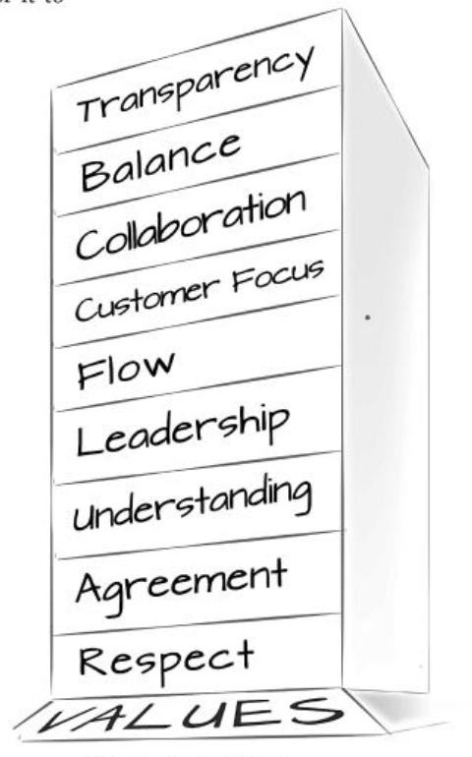
Kanban Values

Slide 93
Kanban Values
Transparency
By an open exchange of information and a clear and unambiguous vocabulary you create transparency in all areas.
Balance
You are efficient if you balance the different requirements, views and abilities of all participants among each other.
Collaboration
The Kanban method improves the way people work together. Collaboration is therefore one of its key points.
Customer Focus
The customers and the value (asset) they receive are the natural centre of interest of all persons involved in the company.

Slide 94
Kanban Values
Workflow
Work represents a continuous or occasional flow of values. An important starting point in using Kanban is to recognize and maintain such a flow of work.
Leadership
Leadership is required at all levels to generate value and achieve an improved state.
Understanding
Understanding means first and foremost self-awareness, both from the individual employee as well as from the entire organization to move forward.
Kanban is a method of improvement and improvement requires change, which in turn requires understanding.

Slide 95
Kanban Values
Agreement
In an agreement, all parties agree to pursue goals together.
Different opinions and approaches must be respected.
These different points of view should converge
Respect
Respect for people in the form of appreciation, understanding and consideration is the foundation on which the other values are based

Slide 96
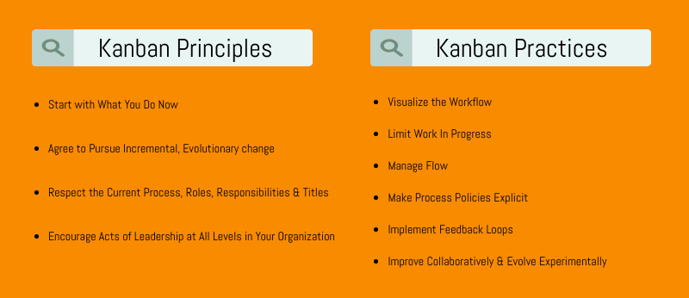
Kanban Principles and Practices

Slide 101
Visualize the Workflow
The first step in improving a process is understanding how the team currently works, and that’s what the Kanban practice visualize is about.
In Kanban, visualizing means writing down exactly what the team does, warts and all, without embellishing it.

Slide 102
Use a kanban board to visualize the workflow
A kanban board is a tool that teams use to visualize their workflow. (The K in the methodology name Kanban is typically uppercase; the k in kanban board is usually lowercase.)
A kanban board looks a lot like a Scrum task board: it typically consists of columns drawn on a whiteboard, with sticky notes stuck in each column. (It’s more common to find sticky notes stuck to kanban boards than it is to find index cards.)
There are three very important differences between a task board and a kanban board.
You already learned about the first difference: that kanban boards only have stories, and do not show tasks.
Another difference is that columns in kanban boards usually vary from team to team. Finally, kanban boards can set limits on the amount of work in a column.

Slide 103
Visualize the Workflow
When a team wants to adopt Kanban, the first thing that they do is visualize the workflow by creating a kanban board.
For example, one of the first kanban boards in David Anderson’s book, Kanban, has these columns: Input Queue, Analysis (In Prog),
Analysis (Done), Dev Ready, Development (In Prog), Development (Done), Build Ready, Test, and Release Ready. This board would be used by a team that follows a process where each feature goes through analysis, development, build, and test.

Slide 104
Kanban Board

Slide 105
This kanban board gives a more accurate and realistic picture of how theproject is run.

Slide 106
Limit Work in Progress
A team can only do so much work at a time. We learned this with Scrum.
When a team agrees to do more work than they can actually accomplish by the time they’d agreed to deliver it, bad things happen.
They either leave some of the work out of the delivery, do a poor job of building the product, or work at an unsustainable pace that will cost dearly in future releases.
Limiting work in progress (WIP) means setting a limit on the number of work items that can be in a particular stage in the project’s workflow.

Slide 107
The number 10 in the Manager Review column is its WIP limit

Slide 108
Measure and Manage Flow
As teams continue to deliver work, they identify workflow problems and adjust their WIP limits so that the feedback loops provide enough information without causing thrashing.
The flow of the system is the rate at which work items move through it.
When the team finds an optimal pace for delivery combined with a comfortable amount of feedback, they’ve maximized the flow.
A Kanban team uses the manage flow practice by measuring the flow and taking active steps to improve it for the team.

Slide 109
Measure and Manage Flow
The kanban board is an important tool for managing flow specifically because it visualizes the source of the problem, and lets you limit work in progress where it will be most effective.
An effective tool for measuring flow is a cumulative flow diagram, orCFD.

Slide 110
Make Process Policies Explicit
Kanban teams don’t need to write long documents or create huge Wikis to establish explicit policies.
Policies can be as simple as WIP limits at the tops of the columns.
Teams can also write down their policies by adding “definitions of done” or “exit criteria” bullets to the bottom of each column on a kanban board, so that the team members know exactly when to advance the work items through the workflow.
This is especially effective when these policies were established collaboratively and evolved experimentally by the whole team, because it means that everyone understands why they’re there.
Complex processes and unwritten rules tend to emerge over time, and they seem to be especially common on teams that have a fractured perspective.

Slide 111
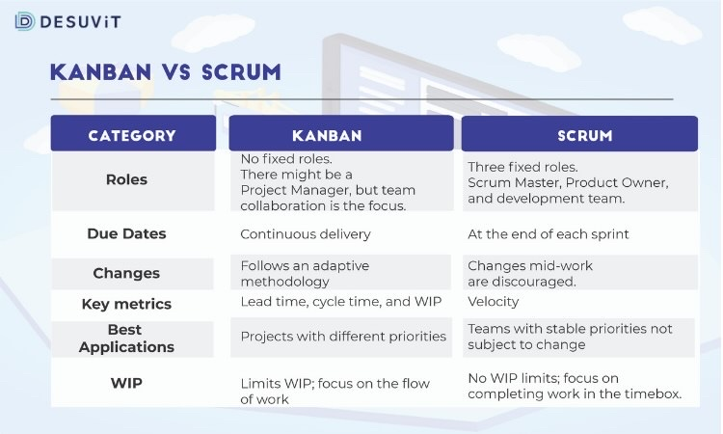

Slide 112
Little’s Law
A theorem that’s part of queueing theory—named for its discoverer, John Little, who first proposed it in the 1950s, and who is considered by many to be the father of marketing science And even though there’s a Greek letter involved, you don’t need to know a lot of math to use it:
L = W × λ
W = L ÷ λ
λ= Arrival rate
L= Inventory
W= Average Lead time
This means that if you have a stable workflow, the average inventory is always equal to the average arrival rate multiplied by the average lead time.

Slide 113
Little’s Law Example.,
If the office staff schedules 11 patients to arrive every hour (so the arrival rate λ is 11/hour), and the office has average inventory of seven patients over the course of the day (so the inventory L is 7), then Little’s Law tells us the average time patients have to wait:
W = L ÷ λ = 7 patients ÷ (11 per hour) = .63 hours = 37 minutes

